Slide 1
GA4 E-commerce
Performance Dashboard
Graduation Project for GoIT
Looker Studio dashboard built with SQL-transformed GA4 BigQuery ecommerce data.
Günışığı Aydoğan
BigQuery → SQL Views → Looker Studio

Slide 2
Table of Contents
Project Objective
Technical Tasks
Looker Studio Dashboard Overview
Key Performance Indicators
Page 3
Page 4, Page 5, Page 6, Page 7, Page 8, Page 9
Page 10, Page, 11
Page 12
1
2
3
4
Dashboard Charts
Interactive Dashboard Filters
Dashboard Design Principles
Conclusion
Page 13, Page 14, Page 15, Page 16, Page 17, Page 18
Page 19
Page 20
Page 21
1
2
3
4

Slide 3
Project Objective
This project presents an interactive GA4 e-commerce performance dashboard created in Looker Studio using SQL-transformed data from BigQuery. The dashboard analyzes sessions, purchases, revenue, conversion rate, customer journey funnel steps, traffic sources, landing pages, and device-based performance.
Data Source
Public GA4 ecommerce sample dataset in BigQuery.
The dataset is transformed using SQL before visualization.
Dashboard Tool
Looker Studio is used to create the online dashboard, filters, KPI cards, and interactive charts.
Business Focus
Track user acquisition, funnel drop-off, revenue performance, landing page quality, and device conversion.

Slide 4
Technical Tasks: SQL View 1: Main E-commerce Dashboard Dataset
In this SQL query, a main dashboard view named ga4_ecommerce_dashboard was created in BigQuery. The raw GA4 event-level data was transformed into a session-level dataset that can be used directly in Looker Studio.
01
Session date and session start time
User and session identifiers
Landing page
Traffic source, medium, and campaign
Device category, language, and operating system
E-commerce funnel events
Purchases, transactions, and revenue
The query extracted key fields such as:

Slide 5
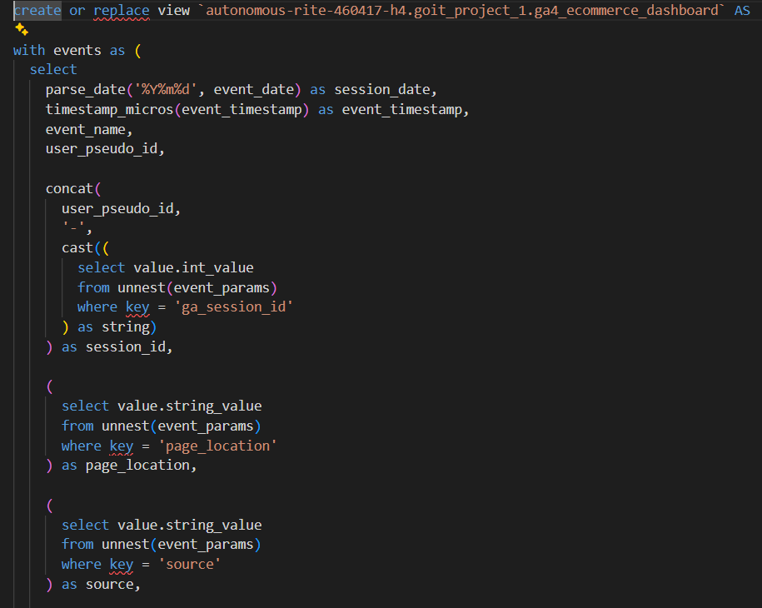
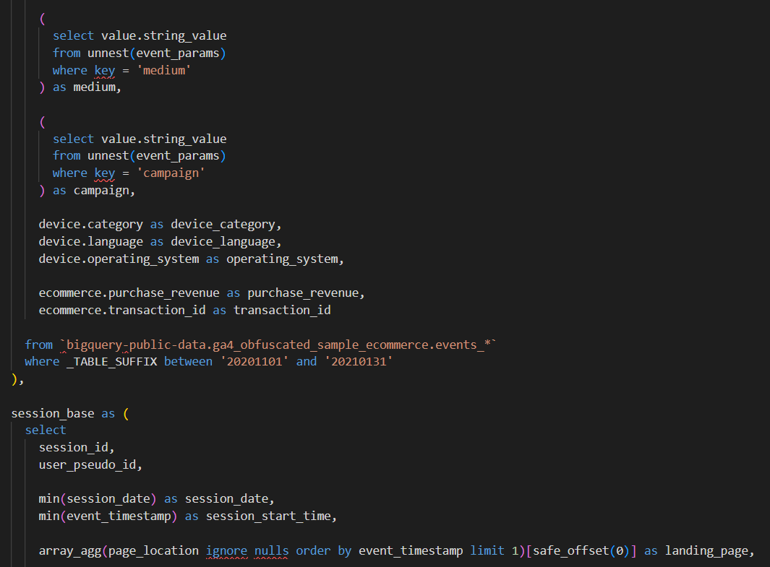
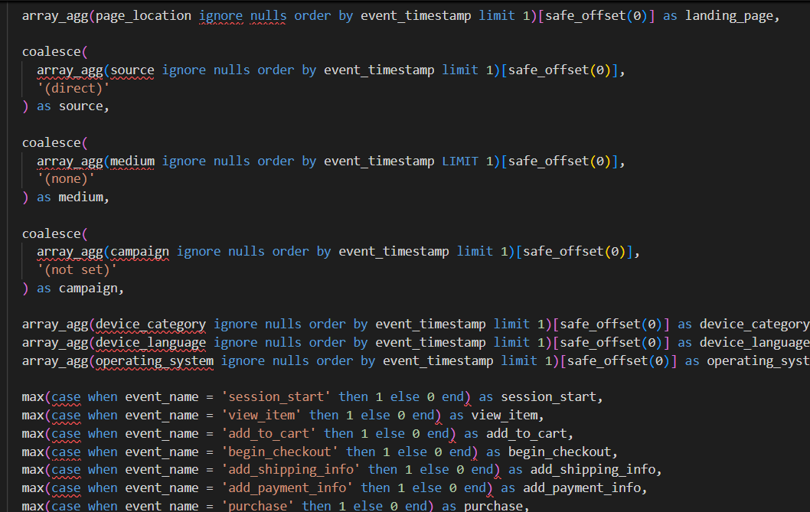
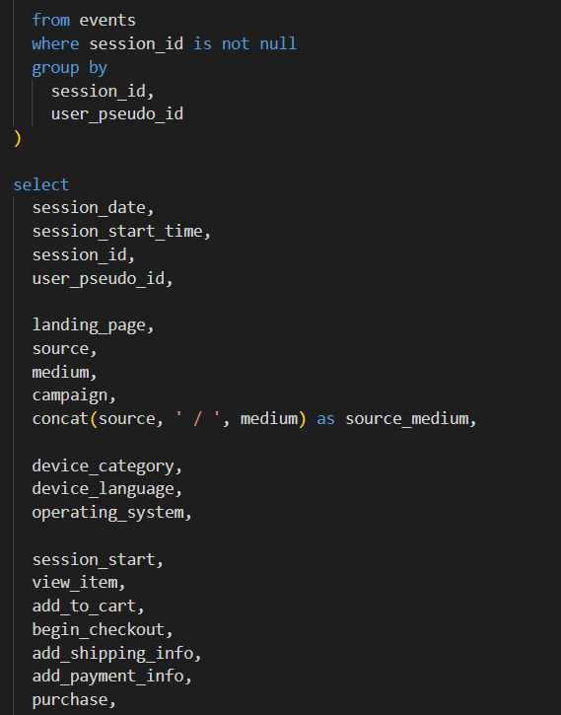
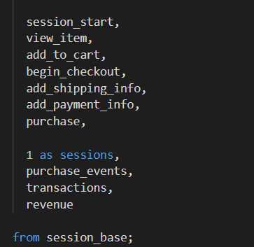
First SQL File:
kpi-project.sql

Slide 6
First SQL File:
kpi-project.sql
02
This view was used as the main data source for KPI cards, trend charts, revenue analysis, landing page performance, device conversion analysis, and dashboard filters.
What We Used It For:

Slide 7
Technical Tasks: SQL View 2: E-commerce Funnel Dataset
This SQL view was created to prepare the e-commerce funnel data for visualization. It transforms the session-level event flags from the main dashboard view into a step-by-step funnel structure. Each funnel step is labeled, ordered, and aggregated by sessions.
01
Session Start
View Item
Add to Cart
Begin Checkout
Add Shipping Info
Add Payment Info
Purchase
The view includes seven ordered funnel steps:

Slide 8
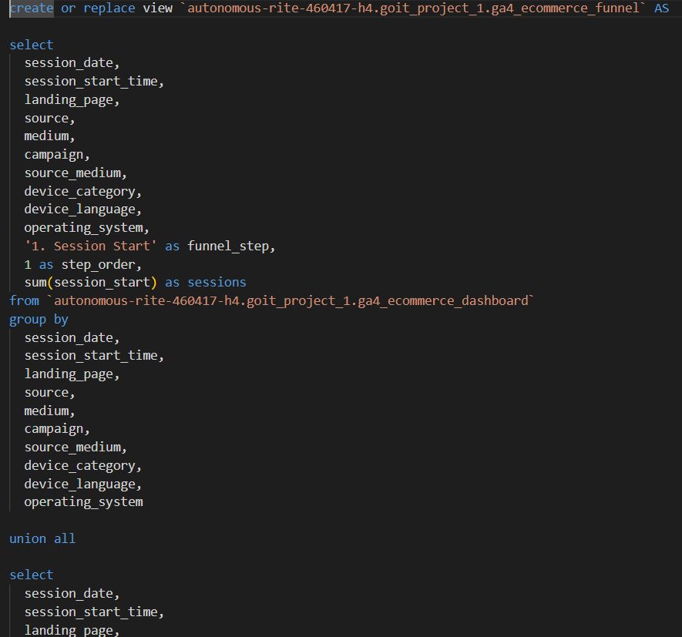
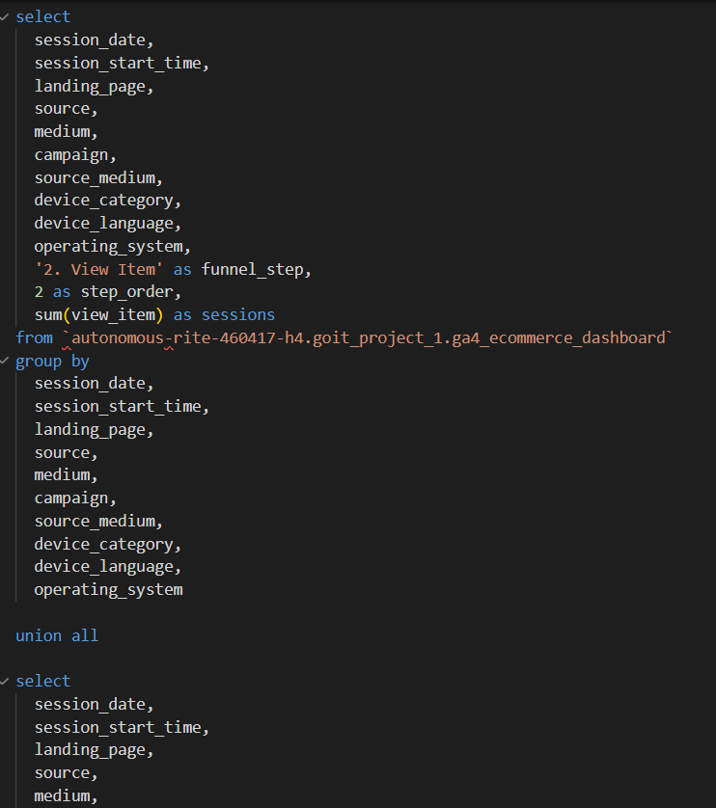
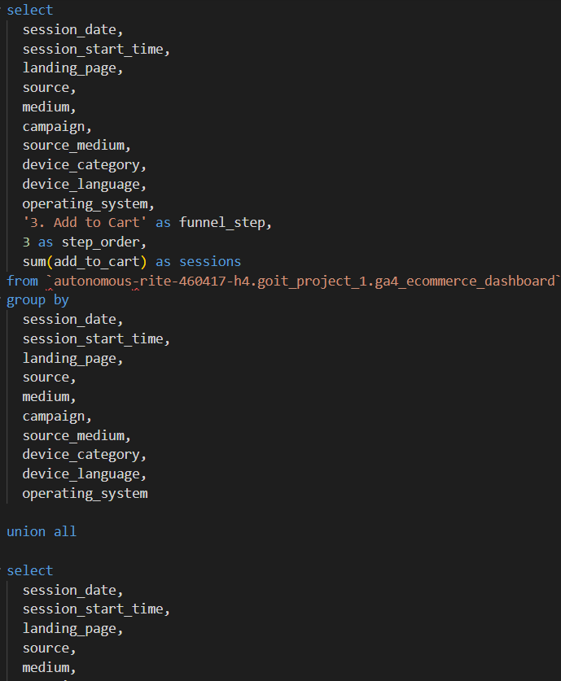
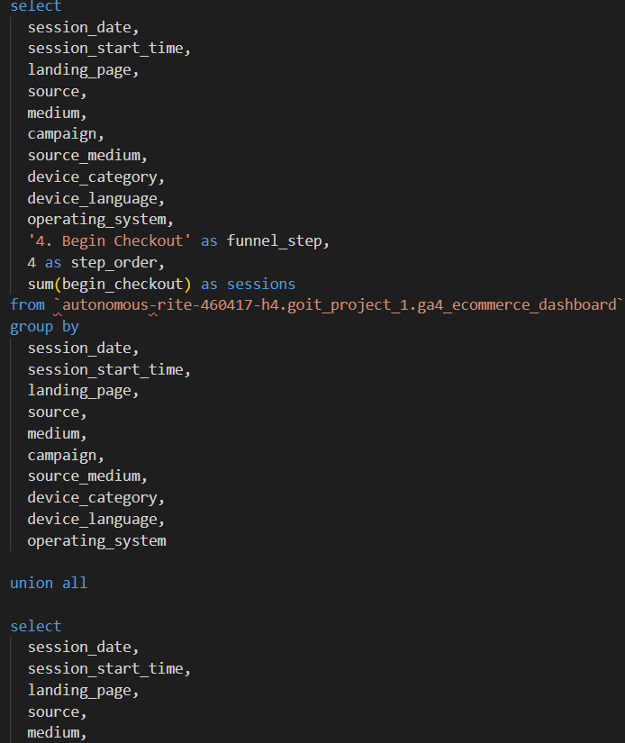
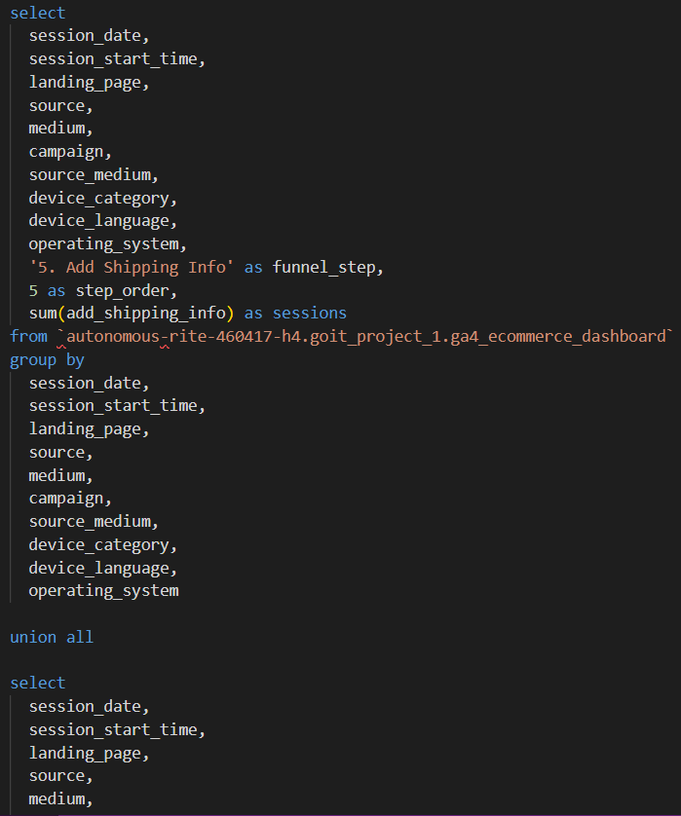
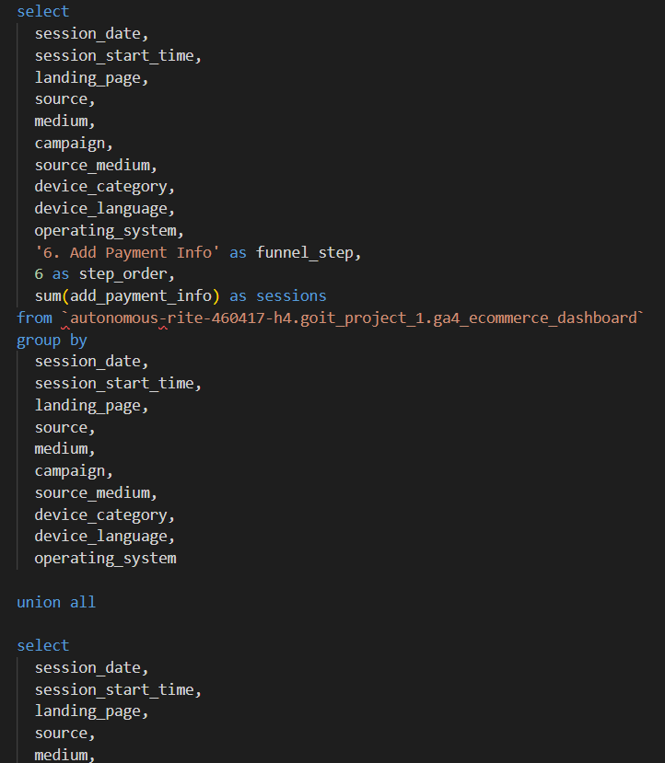
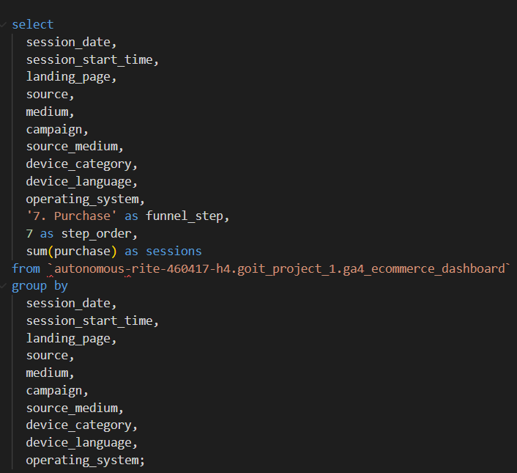
Second SQL File:
funnel-project.sql

Slide 9
Second SQL File:
funnel-project.sql
02
This view was used as the data source for the E-commerce Conversion Funnel chart. It allows the dashboard to show how users move from the beginning of a session to the final purchase step.
What We Used It For:

Slide 10
Looker Studio Dashboard Overview
The Looker Studio dashboard was designed to present the main e-commerce performance indicators in a clear and interactive format. It includes KPI cards, a conversion funnel, trend charts, revenue analysis, landing page performance, and device-based conversion insights.
The dashboard allows users to filter the data by session date, landing page, traffic source, medium, campaign, device category, language, and operating system.

Slide 11
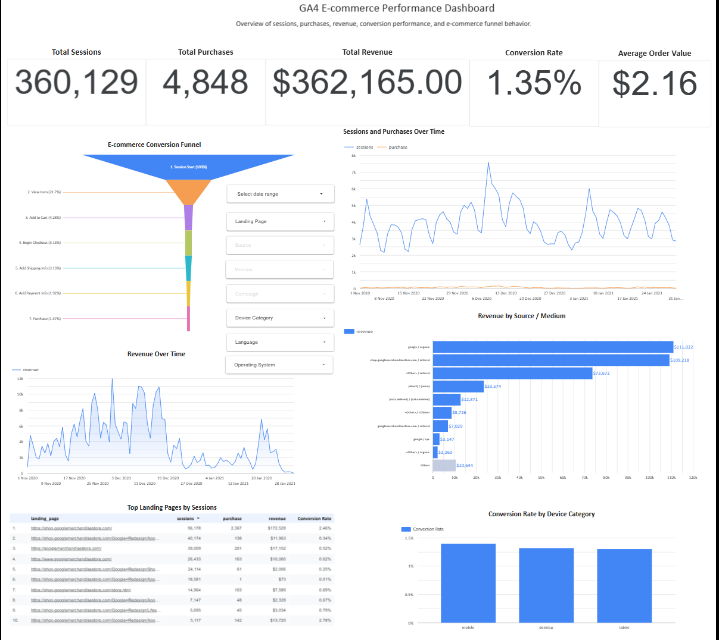
Looker Studio Dashboard:
project_last_-_Günışığı_Aydoğan.pdf

Slide 12
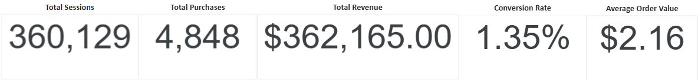
360,129
4,848
$362,165.00
1.35%
$2.16
Total Sessions
Total Purchases
Total Revenue
Conversion Rate
Average Order Value
Shows the total number of website sessions.
Shows the number of sessions that ended with a purchase.
Measures the percentage of sessions that resulted in a purchase.
Shows the average revenue generated per transaction.
Shows the total revenue generated from purchases.

Slide 13
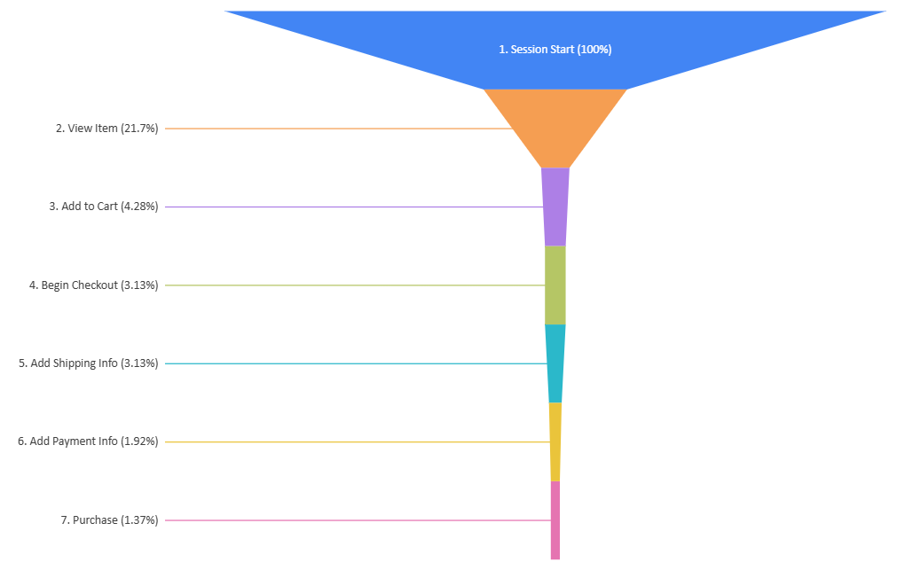
E-commerce Conversion Funnel
The funnel chart visualizes the user journey from Session Start to Purchase. It shows how many users continue through each e-commerce step and helps identify major drop-off points. The largest drop occurs between Session Start and View Item, while the final Purchase step represents completed conversions.

Slide 14
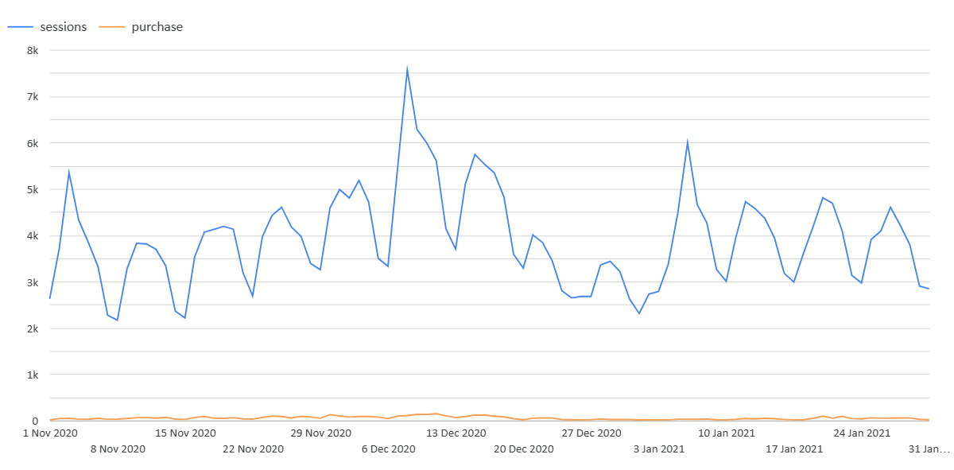
This chart shows daily sessions and purchases over time. It helps compare website traffic with purchase activity and identify traffic peaks, drops, and possible changes in user behavior during the selected period.
Sessions and Purchases Over Time

Slide 15
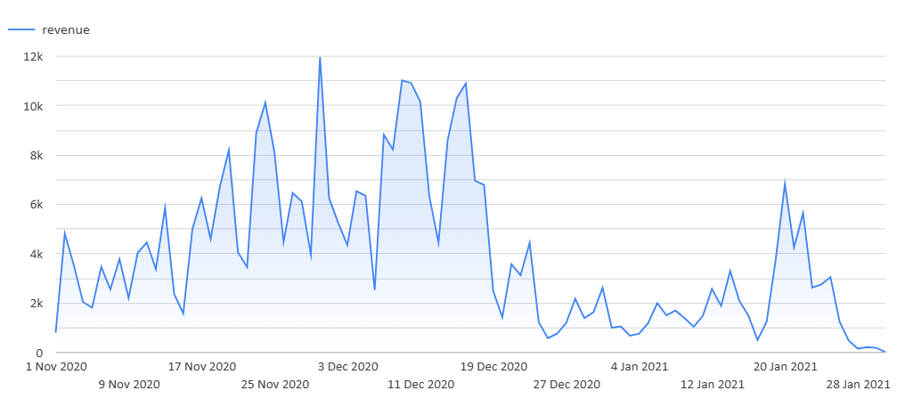
This chart visualizes daily revenue performance over time. It helps track sales trends, identify high-revenue periods, and observe decreases in revenue during the selected date range.
Revenue Over Time

Slide 16
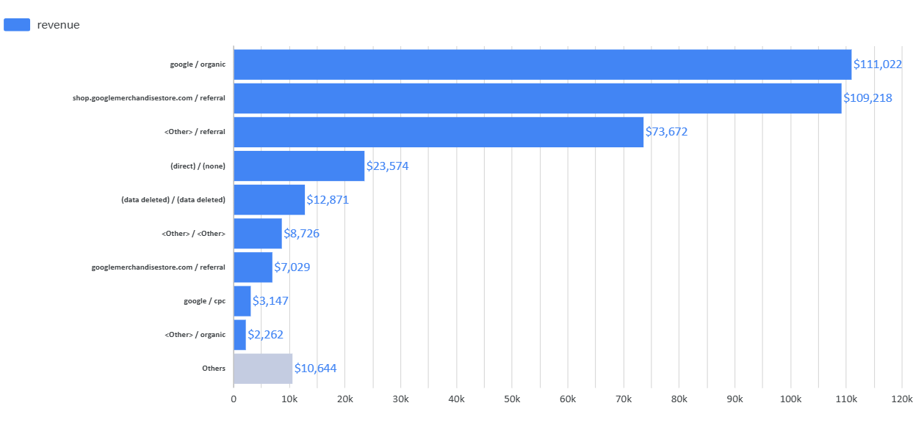
This chart compares revenue performance by source and medium. It shows which traffic channels generated the most revenue and helps evaluate the effectiveness of acquisition sources.
Revenue by Source / Medium

Slide 17
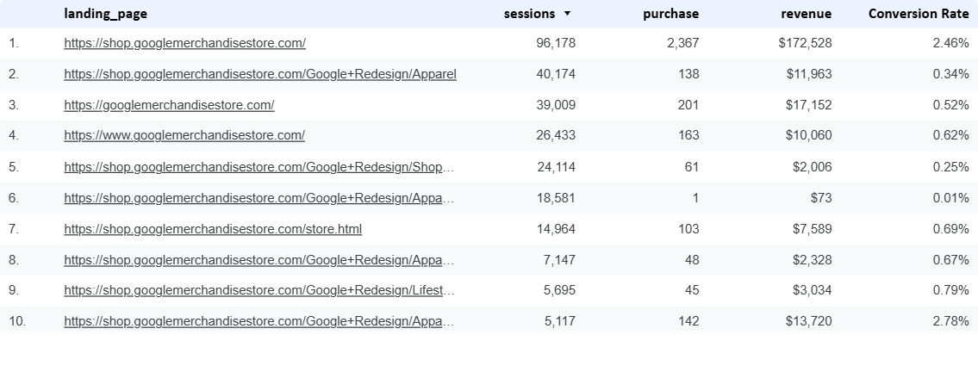
This table compares the top landing pages by sessions, purchases, revenue, and conversion rate. It helps identify which pages drive the most traffic and which pages perform better in terms of sales and conversions.
Revenue by Source / Medium

Slide 18
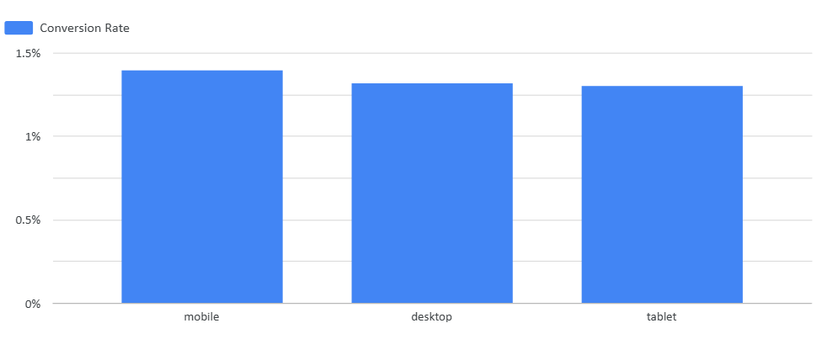
Conversion Rate by Device Category
This chart shows conversion rate by device category. It compares mobile, desktop, and tablet performance and helps identify which device type converts users more effectively.

Slide 19
Interactive Filters
The dashboard includes interactive filters that allow users to explore the data by session date, landing page, source, medium, campaign, device category, language, and operating system. These filters make the dashboard more flexible and help users analyze specific traffic segments and user behaviors.
Date Range
Medium
04
Campaign
Operating System
08
01
03
Landing Page
Source
05
07
02
Device Category
Language
06

Slide 20
Design Principles
The dashboard was designed according to clear visualization principles. KPI cards were placed at the top to support the five-second rule, the most important charts were positioned prominently, labels and metric names were kept clear, and a consistent color scheme was used throughout the dashboard.
5-second principle
Important information first
Clear labels
Consistent color scheme
KPIs are placed at the top for instant understanding.
Funnel and trend visuals appear before detailed breakdowns.
Charts use descriptive English titles and readable metric names.
One restrained palette is used across the dashboard.

Slide 21
Conclusion
This project demonstrates how GA4 BigQuery data can be transformed with SQL and presented through an interactive Looker Studio dashboard. The dashboard helps analyze e-commerce performance, user behavior, revenue trends, conversion funnel steps, landing pages, traffic sources, and device-based conversion rates.

Slide 22
GA4 E-commerce
Performance Dashboard
Graduation Project for GoIT
Looker Studio dashboard built with SQL-transformed GA4 BigQuery ecommerce data.
Günışığı Aydoğan
BigQuery → SQL Views → Looker Studio

